Slide 1



END OF PLACEMENT PRESENTATION
PROJECT TITLE: Low-Cost Sensors Project
SUPERVISORS: Pete Edwards and Stuart Lacy
INTERN NAME: Yann Komenan
INTERN CONTACTs: komenanesli@gmail.com / 07721640840

Slide 2
1. WHAT HAVE I DONE ?
Week 1
Got used to programming in R and using the basics of the most important packages of the Tidyverse (Ggplot2, Dplyr etc)
Got used to the working environment (ID card, tuckshop, the people, the library, the shops etc)
Stuart showed me some of the LCS in the garage and some of the reference instruments as well

Slide 3
1. WHAT HAVE I DONE ?
Week 2, Week 3 and early Week 4:
MAIN TASK: Worked with the LCS data (focused on the Zephyr and AQMesh data) and the reference data.
OBTAINED SKILLS: Was able to practice my data wrangling and analysis skills and go further than what I learned during Week 1.

Slide 4
1. WHAT HAVE I DONE ?
Late Week 4, Week 5 and Week 6:
MAIN TASK: Worked with the diffusion tubes data and linked them to the LCS and reference data.
OBTAINED SKILLS: Got confronted to coding problems linked to dealing with real world data and learned to write more efficient code

Slide 5
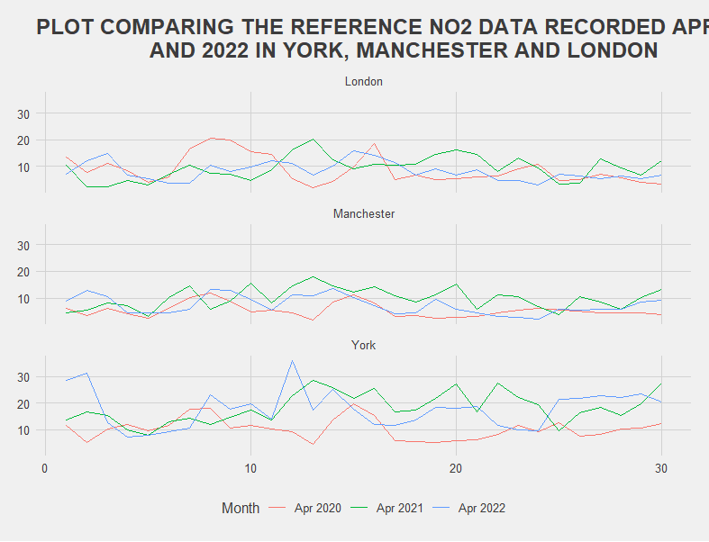
2. LCS DATA
2.1 Reference data
Much higher values in York (>30 ppb sometimes).
The difference between COVID (April 2020) and after COVID (April 2021 and 2022) is also much more noticeable in York.

Slide 6
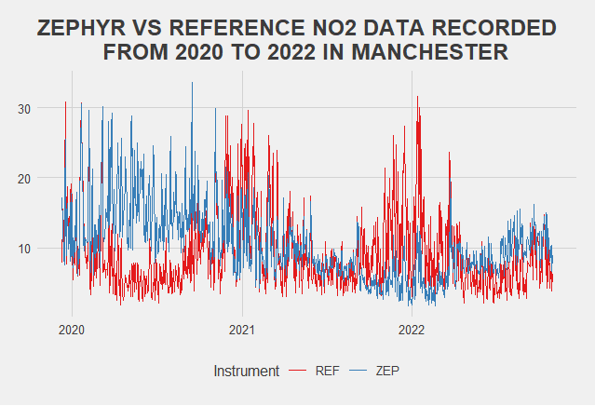
2. LCS DATA
2.2 Suspicious Zephyr data
This plot compares measurements in MANCHESTER only
It is observed that, during the COVID season, the Zephyr measurements did not decrease while it normally should have.
This might be because of the calibration that is done on the instruments.
After COVID, The Zephyr measurements look quite close to the reference.

Slide 7
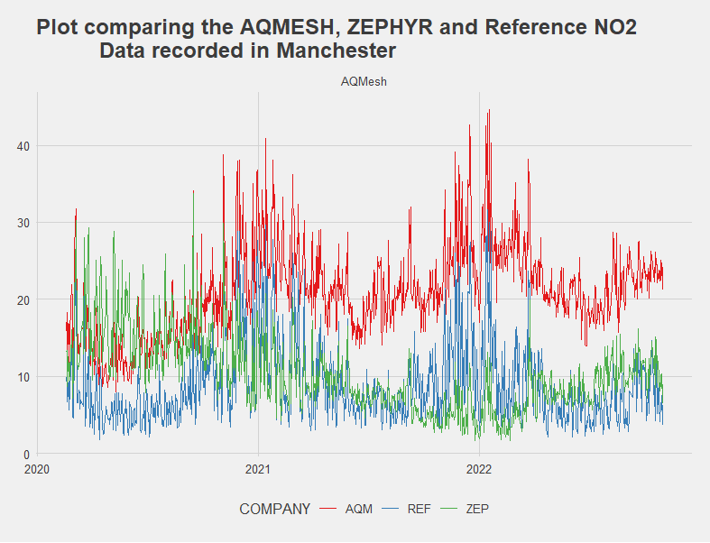
2. LCS DATA
2.3. AQMesh VS Zephyr VS Reference
This plot compares measurements in MANCHESTER only
This plot already reveals two different behaviors from Zephyr and AQMesh instruments.
AQMesh measurements are not very close to the reference, but their movements are very similar (going up and down together).
Meanwhile, Zephyr measurements are closer to the reference, but their movements do not follow the reference’s.

Slide 8
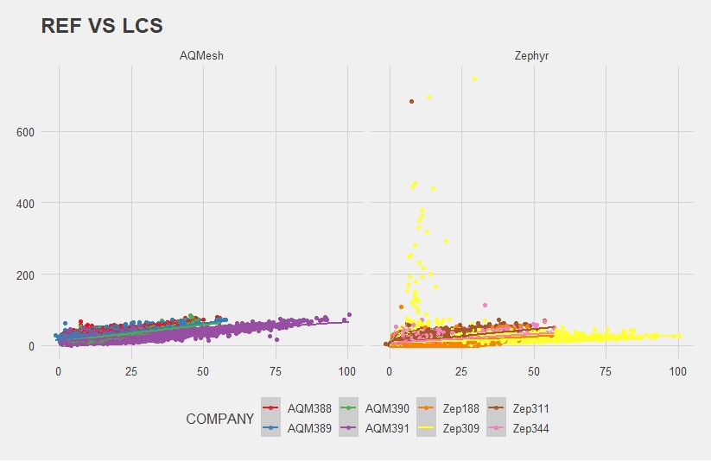
2. LCS DATA
2.4. Accuracy of the LCS
Linked the LCS with the reference data to calculate the accuracy of each sensor using:
hourly data
Cal2 version for AQMesh
Out-of-box version for Zephyr
Presence of suspicious data (between 200 and 600 ppb) in the Zephyr data.
AQM had the same type of measurements at the same period but flagged them
Zephyr did not

Slide 9
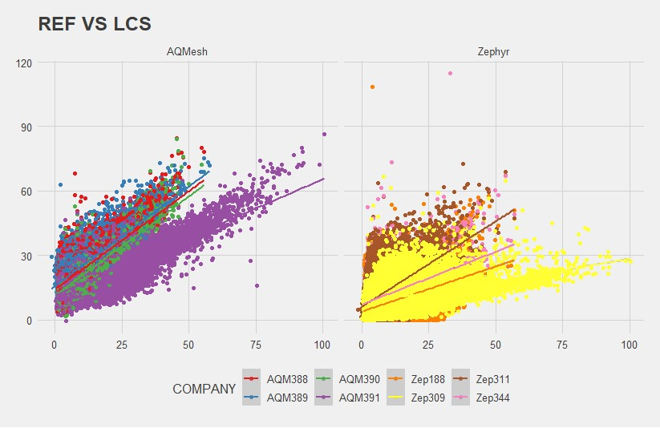
2. LCS DATA
2.4. Reference VS LCS (corrected data)
INSTRUMENT | RMSE | R2
AQM388 | 14.5 | 0.612
AQM389 | 16.1 | 0.578
AQM390 | 11.6 | 0.703
AQM391 | 8.81 | 0.626
Zep188 | 9.16 | 0.142
Zep309 | 13.4 | 0.146
Zep311 | 8.29 | 0.366
Zep344 | 7.72 | 0.282
The corrected data reveal that the Zephyr data have the best RMSEs, but the AQMesh data have the best R2s.

Slide 10
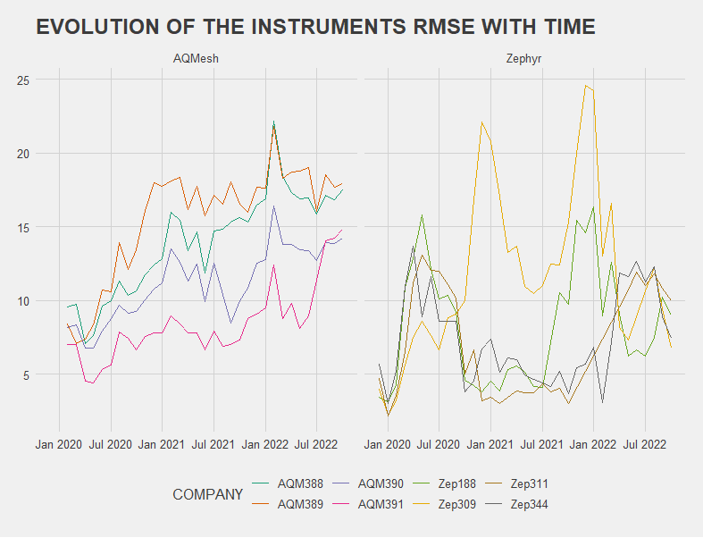
2. LCS DATA
2.5. Instrument RMSE with time
Zephyr sensors seems to have a strong seasonal pattern. A very noticeable change in RMSE happens around January of each year. The accuracy seems to considerably decrease in winter.
AQMesh instruments, on the other hand, behave more consistently. The winter’s RMSE peaks are still there but less noticeable. The dominant pattern is a slow decrease of the sensors accuracy with time.

Slide 11
2. LCS DATA
The Covid season revealed that the Zephyr instruments calibration considerably diminished their dependency to the actual NO2 present in the atmosphere in which they are.
MID-WAY
CONCLUSIONS
This deduction is supported by the fact that the Zephyr data, despite having the best RMSEs, have worse R2s than the AQMesh data.

Slide 12
2. LCS DATA
AQMesh and Zephyr sensors also have two different failure modes.
While AQMesh has a relatively steady decrease of its accuracy with time, Zephyr has a more seasonal one (considerable decrease in winter)
This decrease might be because of the higher atmospheric concentration of NO2 during winter, making the sensors more prone to errors.
MID-WAY
CONCLUSIONS

Slide 13
3. DIFFUSION TUBES DATA
IMPORTANT
NOTES
Only Traditional Shelter data were used because there no traditional mounting in York
The average were converted from ugm-3 to ppb by dividing by 1.9125
The calculated monthly offset between Tubes data and LCS data was applied to hourly LCS data in order to correct them.
The calculated offset between Tubes data and LCS data for one month was applied to the following month (i.e., the offset between March 2021 diffusion tubes data and LCS data was applied on April 2021 LCS data to correct them)

Slide 14
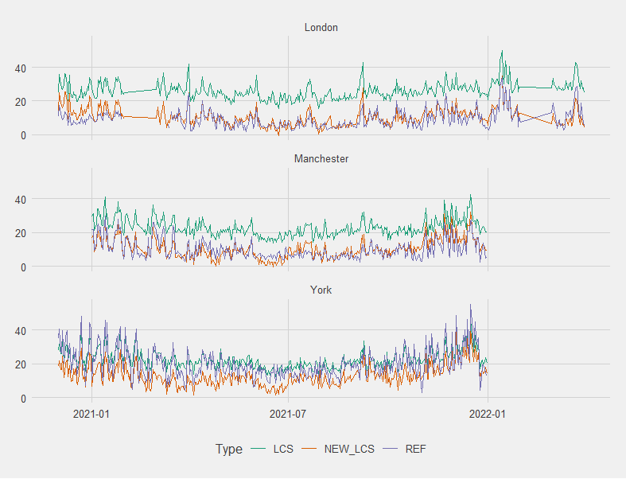
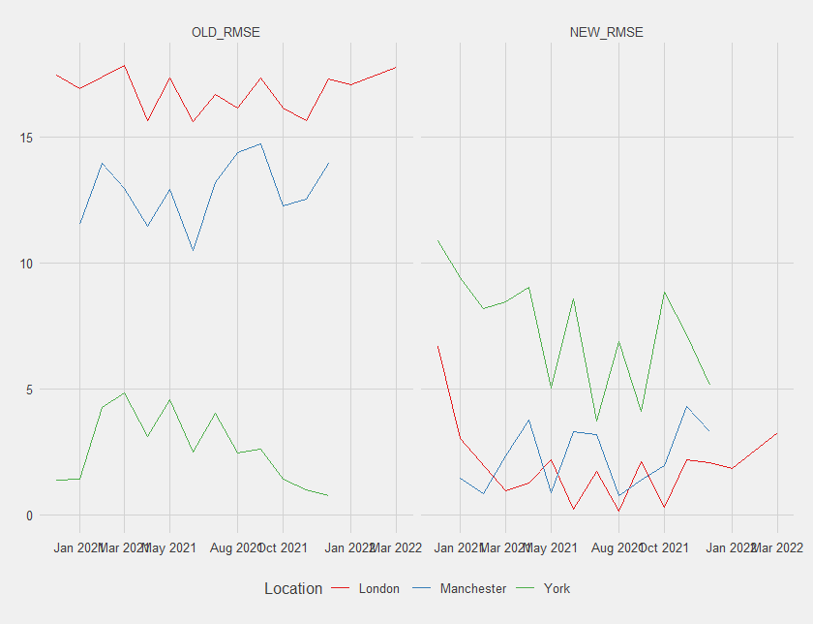
3. DIFFUSION TUBES DATA
3.1. New AQMesh values and RMSES

Slide 15
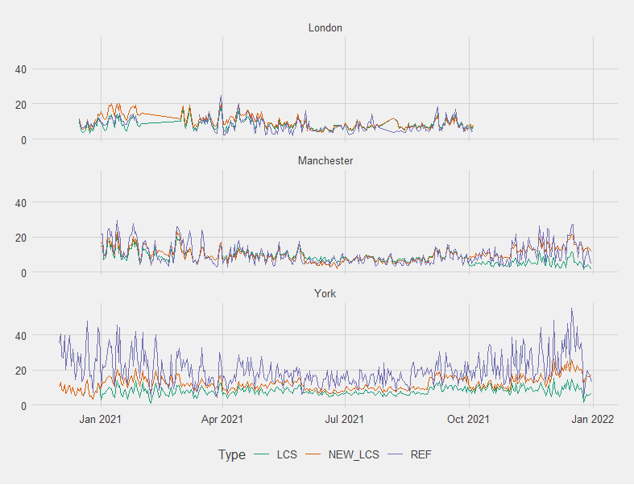
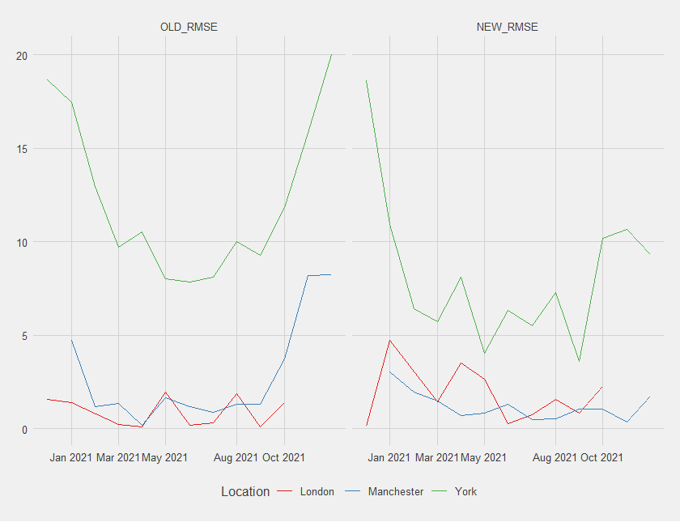
3. DIFFUSION TUBES DATA
3.1. New Zephyr values and RMSES

Slide 16
3. DIFFUSION TUBES DATA
AQMESH
ZEPHYR
LOCATION | INSTRUMENT | OLD_RMSE | NEW_MEAN RMSE | NEW_MEDIAN RMSE
London | AQM389 | 17.3 | 4.82 | 5.48
Manchester | AQM388 | 14.8 | 4.91 | 5.25
Manchester | AQM390 | 11.7 | 4.89 | 5.18
York | AQM391 | 7.89 | 10.6 | 9.70
LOCATION | INSTRUMENT | OLD_RMSE | NEW_MEAN RMSE | NEW_MEDIAN RMSE
London | ZEP311 | 3.78 | 4.37 | 4.97
Manchester | ZEP188 | 8.44 | 5.73 | 5.66
Manchester | ZEP344 | 5.33 | 4.81 | 4.84
York | ZEP309 | 16.3 | 13.4 | 13.1
Concerning AQMesh, the calibration seems to have worked very well in London and Manchester. However, in York, the new values seem to be worse than the old ones. Both when using the Median and the mean.
Concerning Zephyr, there is not much change in London and Manchester. The RMSEs were already quite good. But, there is a slight improvement of the York’s measurements.

Slide 17
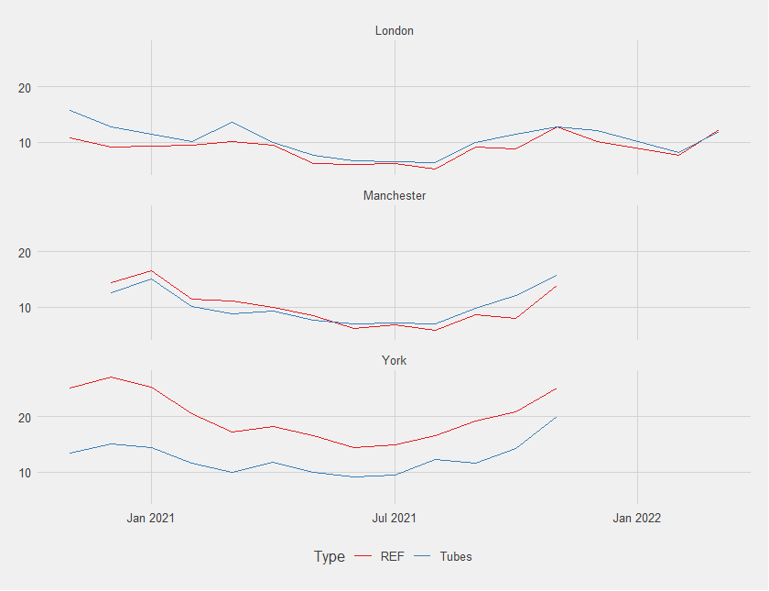
3. DIFFUSION TUBES DATA
3.5. Tubes VS Reference
LOCATION | RMSE_MEAN | RMSE_MEDIAN
London | 2.23 | 3.90
Manchester | 1.77 | 2.47
York | 7.97 | 5.74
The tubes data are very accurate in London, but not accurate at all in York. This might explain why the calibration is not having the desired effect in York.

Slide 18
3. DIFFUSION TUBES DATA
FINAL
CONCLUSIONS
AQMesh would be the best company to use the tube calibration on because it is consistent and quite correlated to reference data.
The calibration showed itself to be extremely effective in background settings but very ineffective close to roadsides where the measurements become even worse in some cases.
That is because the diffusion tubes measurements are not accurate in York.

